Slide 1

មជ្ឈមណ្ឌលកូរ៉េ សហ្វវែរ អេច អ ឌី
Korea Software HRD Center
ប្រធានបទ៖ មូលដ្ឋានគ្រិះរបស់ភាសា Java
ឣ្នកប្រឹក្សាយោបល់: បណ្ឌិត​​ គីម​ ថេខ្យុង
ឣ្នកណែនំា: លោក លាង ប៊ុនរ៉ុង
លោក លន់ សុវត្ថានា
លោក ផេង តុលា
លោក ដារ៉ា ពេញចិត្ត
www.kshrd.com.kh

Slide 2
សមាជិក
Mr. Touch Sophonara
Mr. Phone Kimseak
Mrs. Moeung Theara
Mr. Nuon Veyo
Mr. Ly Pisith

Slide 3
មាតិកា
Primitive Data Type / Wrapper Class
Auto Boxing
Promotion and Casting
Operator
System Class input / output
Scanner Class
BufferedReader / InputStreamReader

Slide 4
Primitive Data Type
ចំពោះ Primitive Data Type មានចំនួនទាំងអស់ចំនួន ៨ ដែលយើងអាចចែកជា 4 ក្រុមគឺ
Character | Integer | Floating | Boolean
char – 2 bytes | byte – 1bytes | float – 4bytes | boolean – 1 bit
 | short – 2bytes | double – 8bytes
 | int – 4bytes
 | long – 8bytes

Slide 5
Primitive Data Type
Type | Contains | Default | Size | Range
Boolean | True of false | False | 1 bit | NA
char | Unicode character | \u00000 | 16bits | \u00000 to \uFFFF
byte | Signed integer | 0 | 8bits | -128 to 32767
short | Signed integer | 0 | 16bits | -32768 to 32767
int | Signed integer | 0 | 32bits | -2147483648 to 2147483648
long | Signed integer | 0 | 64bits | -9223372036854775808 to 9223372036854775807
float | IEEE 754 floating point | 0.0 | 32bits | ±1.4E-45 to ±3.4028235E±38
double | IEEE 754 floating point | 0.0 | 64bits | ±4.9E-324 to ±1.7976931348623157E±308
Notes:
A relational operator compares two values and determines the relationship between them. For example, != returns true if its two operands are unequal. Relational operators are used to test whether two values are equal, whether one value is greater than another, and so forth. The relation operators in Java are: ==, !=, <, >, <=, and>=. The meanings of these operators are:

Slide 6
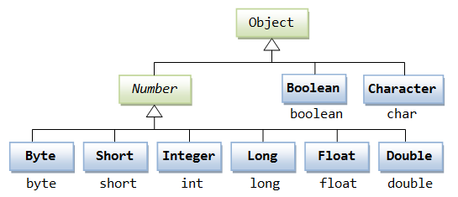
What is a wrapper class?
.
In Java, a wrapper class ជា Class សំរាប់ធ្វើការវេចខ្ចប់ primitive value ដែលយើងអាចប្រើ Object សំរាប់តំណាងឲ្យ Primitive Data Type។

Slide 7
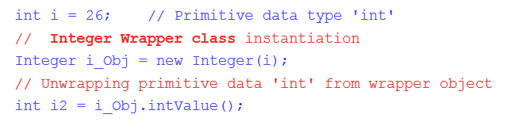
Wrapper Class Example
Example
Primitive Data Type | Wrapper Class
byte | Byte
short | Short
int | Integer
long | Long
float | Float
double | Double
char | Character
boolean | Boolean

Slide 8

Why do we need wrapper classes in java?
តើយើងពិតជាត្រូវការ wrapper class រឺ​​
wrapper data types ក្នុង java មែនទេ?
ហេតុអ្វីបានជាយើងមិនប្រើ
primitive data type ដោយផ្ទាល់តែម្តងទៅ
ដោយមិនចំបាច់ប្រើប្រាស់​ wrapper class?

Slide 9

Why do we need wrapper classes in java?
ជាទូទៅ យើងអាចប្រើប្រាស់ Primitive Type បានជាច្រើនកន្លែង ក៏បន្តែមិនទាំងអស់ទេ។
ក្នុងករណីខ្លះយើងមិនអាចប្រើប្រាស់ Primitive value ទេ,​
ដូចនេះយើងត្រូវការប្រើប្រាស់ Wrapper Class ។
ជាឧទាហរណ៍ ប្រសិនបើត្រូវការ store numbers ក្នុង a collection,
យើងមិនអាចប្រើ Primitive data type ទេ
ព្រោះថា collections such as List, Set, and Map need objects
as their elements.

Slide 10
What is the difference between primitive data types and wrapper classes in java?
difference between primitive data types and wrapper classes
primitive types can be used as raw data for operations such as arithmetic, logical, etc.
wrapper classes acts as data holders for these primitive data types.
Important note : The primitive data type values will be stored in Stack Memory whereas wrapper class objects (like any other java objects) are stored in Heap Memory.

Slide 11
Use of wrapper class in java
uses/advantages of wrapper classes.
One feature is to use constants defined by the wrapper class, such as MIN_VALUE and MAX_VALUE, that provide the upper and lower bounds of the data type,
and the other application is to use wrapper class for converting to and from smethods for converting values to and from other primitive data types, trings, and for converting between number systems (decimal, octal, hexadecimal, binary).

Slide 12
Auto Boxing
Auto Boxing គឺជាការបម្លែងដោយ automatic​​ របស់ Java compiler រវាង primitive types និង wrapper classes ​​ ដែលត្រូវគ្នារបស់វា។
Boxing គឺជាការបម្លែងពី primitive types​ទៅជា wrapper classes
Ex: int i =5;
Integer y = i;
.Unboxing​គឺជាការបម្លែងពី wrapper classes ​ទៅជា primitive types
Ex: Integer y =new Integer(5);
int i=y+5;

Slide 13
Auto Boxing Process
Boxing Unboxing​
Wrapper Class
Auto Boxing
Primitive type

Slide 14

Promotion
Promotion គឺជារបៀបនៃការផ្លាស់ប្ដូរតម្លៃឬប្រភេទទិន្នន័យដោយមិនមានបាត់បង់តម្លៃឬ(ពីDatatype តូច ទៅ Datatypeធំ)។
Storing narrower int value to a wider datatype double

Slide 15
Promotion Rule
1.All byte and short value are promoted to int
public class Test {
public static void main(String[] args) {
Byte y =65;
int x = y;
System.out.println(x);
}
}

Slide 16
2. If one operand is a long ,the whole expression is promoted to long
public class Main {
public static void main(String args[]) {
byte b = 4;
long f = 550;
long result = (f * b);
System.out.println("f * b = " + result);
}
}
The output: f * b = 2200

Slide 17
3. If one operand is a float, the entire expression is promoted to float.
public class Main {
public static void main(String args[]) {
byte b = 4;
float f = 5.5f;
float result = (f * b);
System.out.println("f * b = " + result);
}
}
The output: f * b = 22.0

Slide 18
4.If any of the operands is double, the result is double
public class Main {
public static void main(String args[]) {
short s = 1024;
double d = .1234;
double result = d * s;
System.out.println("d * s is " + result);
}
}
The output : d * s is 126.3616

Slide 19

Casting
Casting គឺជារបៀបនៃការផ្លាស់ប្ដូរតម្លៃឬប្រភេទទិន្នន័យដែលអាចបាត់បង់តម្លៃឬ(ពី Datatypeធំ ទៅ Datatype តូច )។
​​​​​​​​​​​​​​​​​​​​ Storing wider double value to a narrower datatype int

Slide 20
Primitive casting
Primitive casting គឺជាការConversionពីPrimitive Datatypeធំ ទៅ Primitive Datatype តូច ។
​​​ public class Test {
public static void main(String args[]) {
float a=234;
byte b =(byte)a;
System.out.println("d * s is " + b);
}
}

Slide 21
Primitive casting rules
1.Cast any non-boolean primitive to any non-boolean primitive type
public class Test {
public static void main(String args[]) {
double d = 8.5768;
byte b = (byte) d; // double to byte casting
char c = (char) d; // double to char casting
short s = (short) c; // char to short casting
System.out.println("d * s is " + b +c +s +x);
}
}

Slide 22
2.Can not cast a boolean to any other type than boolean
public class Test {
public static void main(String args[]) {
double d = 1.0;
boolean b = (boolean) d; // Compile time Error!
System.out.println("d * s is " + b);
}
}

Slide 23
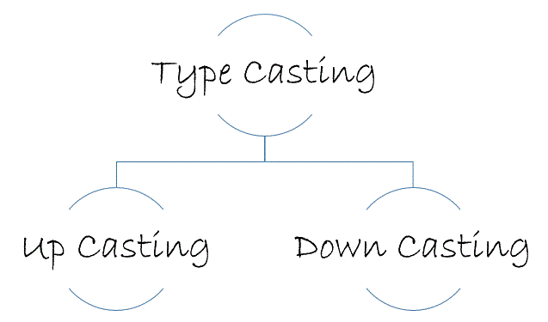
Object reference casting
Object reference casting គឺជាការផ្លាស់ប្ដូរTypeរបស់Object referenceរបស់Subclass និង​Supperclass។

Slide 24
Upcasting
Upcasting គឺជាការបម្លែងប្រភេទObject TypeនៃSubclassទៅជា Object Typeរបស់Supperclass ។
​​
public class Student extends Person {
​​​​ public static void main(String args[]) {
Person p =new Student(); //Valid casting
​ }
​​ }

Slide 25
Down casting
Down casting គឺជាការបម្លែងប្រភេទ Object Typeរបស់Superclass Object Typeនៃ Supper class ទៅជា Object Typeរបស់ Subclass ។
public class Student extends Person {
public static void main(String args[]) {
Person p =new Person();
Student s =(Student) p; //Valid casting
​ }
​​ }

Slide 26
Operators in Java
Java បានផ្ដល់នូវប្រភេទនៃ​ Operator ជាច្រើនសំរាប់ឲ្យយើងធ្វើការប្រើប្រាស់ជាមួយនឹង variables​ មានដូចជា៖
Arithmetic Operators
Relational Operators
Bitwise Operators
Logical Operators
Assignment Operators
Miscellaneous Operators

Slide 27
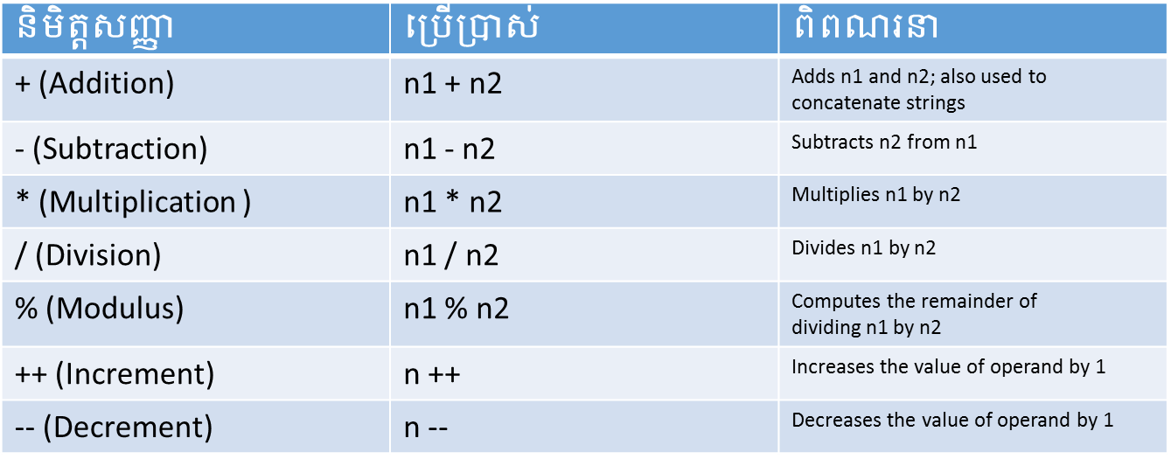
Arithmetic Operators
នៅក្នុង Java Arithmetic Operators ត្រូវបានប្រើប្រាស់សំរាប់គណនាតំលៃណាមួយ។ Operator ទាំងនោះមានដូចជា៖

Slide 28
Relational Operators
Relational Operator ប្រើសំរាប់ធ្វើការប្រៀបធៀបតំលៃពីរដែលមានទំនាក់ទំនងគ្នារវាងតំលៃពីរនោះ
Relational Operator ត្រូវបានប្រើដើម្បី Test មើលថាតើតំលៃពីរស្មើរគ្នាឬតំលៃមួយធំជាងតំលៃផ្សេងទៀត។
Relational Operator នៅក្នុង Java មានដូចជា៖​ ==, !=, <, >, <=, and>=
use | Return if true
n1 > n2 | n1 is greater than n2
n1 >= n2 | n1 is greater than or equal to n2
n1 < n2 | n1 is less than to n2
n1 <= n2 | n1 is less than or equal to n2
n1 == n2 | n1 and n2 are equal
n1 != n2 | n1 and n2 are not equal
Notes:
A relational operator compares two values and determines the relationship between them. For example, != returns true if its two operands are unequal. Relational operators are used to test whether two values are equal, whether one value is greater than another, and so forth. The relation operators in Java are: ==, !=, <, >, <=, and>=. The meanings of these operators are:

Slide 29
Bitwise Operators
Java បានផ្ដល់នូវ Bitwise Operators មួយចំនួនដែលត្រូវបានប្រើប្រាស់ជាមួយ Integer Type, long, int, short, char and byte.
Operator | Description
& (bitwise and) | Binary AND Operator copies a bit to the result if it exists in both operands. Example: (A & B) will give 12 which is 0000 1100
| (bitwise or) | Binary OR Operator copies a bit if it exists in either operand. Example: (A | B) will give 61 which is 0011 1101
^ (bitwise XOR) | Binary XOR Operator copies the bit if it is set in one operand but not both. Example: (A ^ B) will give 49 which is 0011 0001
~ (bitwise compliment) | Binary Ones Complement Operator is unary and has the effect of 'flipping' bits. Example: (~A ) will give -61 which is 1100 0011 in 2's complement form due to a signed binary number.
<< (left shift) | Binary Left Shift Operator. The left operands value is moved left by the number of bits specified by the right operand Example: A << 2 will give 240 which is 1111 0000
>> (right shift) | Binary Right Shift Operator. The left operands value is moved right by the number of bits specified by the right operand. Example: A >> 2 will give 15 which is 1111
>>> (zero fill right shift) | Shift right zero fill operator. The left operands value is moved right by the number of bits specified by the right operand and shifted values are filled up with zeros. Example: A >>>2 will give 15 which is 0000 1111

Slide 30
Logical Operators
ខាងក្រោមនេះជាប្រភេទនៃ Logical Operators:
Operator | Description
&& (logical and) | Called Logical AND operator. If both the operands are non-zero, then the condition becomes true. Example (A && B) is false.
|| (logical or) | Called Logical OR Operator. If any of the two operands are non-zero, then the condition becomes true. Example (A || B) is true.
! (logical not) | Called Logical NOT Operator. Use to reverses the logical state of its operand. If a condition is true then Logical NOT operator will make false. Example !(A && B) is true.

Slide 31
Assignment Operators
ខាងក្រោមនេះជាប្រភេទនៃ Assignment Operators:
Operator | Description
= | Simple assignment operator, Assigns values from right side operands to left side operand. Example: C = A + B will assign value of A + B into C
+= | Add AND assignment operator, It adds right operand to the left operand and assign the result to left operand. Example: C += A is equivalent to C = C + A
-= | Subtract AND assignment operator, It subtracts right operand from the left operand and assign the result to left operand. Example:C -= A is equivalent to C = C - A
*= | Multiply AND assignment operator, It multiplies right operand with the left operand and assign the result to left operand. Example: C *= A is equivalent to C = C * A
/= | Divide AND assignment operator, It divides left operand with the right operand and assign the result to left operand ExampleC /= A is equivalent to C = C / A
%= | Modulus AND assignment operator, It takes modulus using two operands and assign the result to left operand. Example: C %= A is equivalent to C = C % A
<<= | Left shift AND assignment operator. ExampleC <<= 2 is same as C = C << 2
>>= | Right shift AND assignment operator Example C >>= 2 is same as C = C >> 2
&= | Bitwise AND assignment operator. Example: C &= 2 is same as C = C & 2
^= | bitwise exclusive OR and assignment operator. Example: C ^= 2 is same as C = C ^ 2
| = | bitwise inclusive OR and assignment operator. Example: C |= 2 is same as C = C | 2

Slide 32
Miscellaneous Operators
Condition Operator ( ? : ) ដែលគេដឹងថាជា ternary operator
variable x = (expression) ? Value if true : value if false
instance of Operator ត្រូវបានប្រើសំរាប់តែ object reference variables ប៉ុន្នោះ។ វាធ្វើការពិនិត្យ មើលប្រភេទនៃ Object ( class type ឬ interface type)

Slide 33
Java System Class Input and Output
System class គឺជាsystem class ផ្ទុកនូវ​class fields និង methods សំខាន់ៗជាច្រើនជាពិសេសមុខងារសំរាប់ Input និង​Output។
System Class Output and Input មាន2 Fields គឺ៖
Standard Output
Standard Input ​

Slide 34
System Output
Standard Output
System.out ប្រើដើម្បីធ្វើការDisplay អក្សរ​ទៅលើ Console។
Methods ដែលប្រើដើម្បី Display ចំនួន៣ គឺ៖
print() សំរាប់បង្ហាញអក្សរមួយជួរ។
println() សំរាប់បង្ហាញអក្សរមួយជួរ​រួចចុះបន្ទាត់។
printf() ​សំរាប់បង្ហាញអក្សរដែលយើងអាចកំណត់ជាលេខ រឺ អក្សរ។

Slide 35
System Output
public class Test{
public static void main(String[] args) {
System.out.print(“Hello World!”);
System.out.println(“Hello World!”);
System.out.printf(“Hello World!”);
System.out.printf(“Hello World!”);
}
}
Hello world!
Hello world!
Hello World!
HELLO WORLD!

Slide 36
System Output
System.err យើងប្រើវាដើម្បី​Display Error Message។
public class Error{
public static void main(String[] args){
System.err.println(“ your code error on line…”);
}
}
Your code error on line….

Slide 37
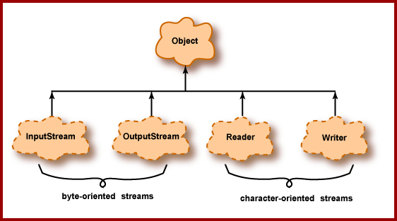
Java System Class Input and Output
Syetem.in
System.in ប្រើដើម្បីចាប់យកទិន្នន័យពី Keyboard​។
Byte Stream ការread ជា1byte​ = 8bit
Character Stream ការ read ជា character 16bit Unicode
Buffered Stream

Slide 38
Class scanner
Java Scanner Class ​គឺpackage java.util​ហើយវាបានផ្ដល់នូវmethodsជាច្រើនសំរាប់read និង​parse data ពី​source files និង​ input stream។​Scanner class បានបំបែក​ the input ទៅជា​tokens ដោយប្រើdelimiter ដោយប្រើ​delimiter (by default delimiter is a white space)។

Slide 39
Scanner Class
Example
import java.io.*;
import java.util.Scanner;
public class MixedTypeInput
{
public static void main(String[] args)
{
double number;
Scanner in = new Scanner(System.in);
System.out.println("Enter your gross income: ");
number = (double)in.nextInt();
System.out.println("You entered " + number);
}
}

Slide 40
Scanner Class
Common used methods របស់​Scanner class
Method | Description
Public String next() | It return the next token from the scanner
Public String nextLine() | It moves the scanner position to the next line and return the value as a string.
Public byte nextByte() | It scans the next token as a byte.
Public short nextShort() | It scans the next token as a short value.
Public int nextInt() | It scans the next token as an int value.
Public long nextLong() | It scans the next token as a long value.
Public float nextFloat() | It scans the next token as a float value.
Public double nextDouble() | It scans the next token as a double value.

Slide 41
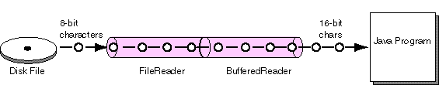
BufferedReader
BufferedReader:គឺជាclass ដែលគេប្រើ ដើម្បី​ read character-input stream ហើយវាផ្តល់នូវ buffering character​​ ដែលមានភាពកាន់តែប្រសើរឡើងក្នុងការ Read character,array រឺ line.
Buffer អាចត្រូវបានកំណត់ជាក់លាក់ រឺ អាចជា Default ដែលមានទំហំ 8192 characters

Slide 42
BufferedReader
method in BufferedReader:
void close()
void mark(int readAheadLimit)
boolean markSupported()
int read()
int read(char[] cbuf, int off, int len)
String readLine()
boolean ready()
void reset()
long skip(long n)

Slide 43
InputStreamReader
InputStreamReader:គឺជាការ Read character ពី file រឺ Network connection ជា byte ហើយ បកប្រែ​ទៅជា characterដោយប្រើ specified charset​ encoding. encoding ដែលប្រើអាច specified រឺ default encoding.
Create an InputStreamReader that uses the default character encoding
Ex:
public InputStreamReader(InputStream in)
Create an InputStreamReader that uses the named character encoding
Ex:
public InputStreamReader(InputStream in, String enc) throwsUnsupportedEncodingException

Slide 44
InputStreamReader
Method Index in InputStreamReader
close() : Close the stream.
getEncoding() : Return the name of the encoding being used by this stream.
read() : Read a single character.
read(char[], int, int) : Read characters into a portion of an array.
ready() : Tell whether this stream is ready to be read.

Slide 45
Reference
http://www.explain-java.com/java-wrapper-class-tutorial-explain-java-wrapper-classes-examples/

